Slide 1
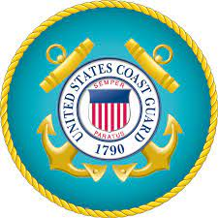
Ensuring Workplace Inclusion for Veterans, Military Spouses, and Caregivers
November 17, 2022 | 5:30 pm – 7:30 pm | 3401 Edwin St.| Savannah Police Department Professional Development Center
Presented by Kenya Harrison
Academic Program Manager for Georgia Institute of Technology’s (GA TECH)
Department of Professional Education-Savannah Campus
SHRM Foundation Veterans At Work Ambassador
RSVP today: shrmsav.wildapricot.org
This is a dinner meeting
Members: Free
Non-members $25 (includes cost dinner

Slide 2
Learning Objectives
Talent Acquisition- Activities involved in building and maintaining a workforce that meets the needs of the organization.
Learning & Development -Activities aimed at enhancing the knowledge, skills, abilities, and other characteristics (KSAOs)and competencies of the workforce to meet the organization’s business needs.
Diversity & Inclusion -Encompasses activities that create opportunities for the organization to leverage the unique backgrounds and characteristics of all employees to contribute to its success.
Total Rewards -Refers to the design and implementation of compensation systems and benefit packages which employers use to attract and retain employees.
Workforce Management -Refers to HR practices and initiatives that allow the organization to meet its talent needs and to close critical gaps in competencies.

Slide 3
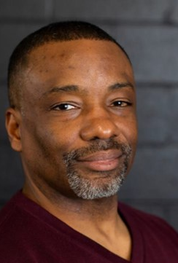
Kenya Harrison Bio
Ken is currently an Academic Program Manager for Georgia Institute of Technology’s (GA TECH) Department of Professional Education-Savannah Campus. He manages the Veterans Education Training and Transition (VET²) Program which offers a one-of-a-kind training and employment initiative for active-duty service members and veterans. Working with regional workforce boards around the state the VET² program supports professional education at no cost to service members. The program provides resume writing and interview skills, military to civilian transition training, Lean Six Sigma, Project Management and Supply Chain and Logistics certifications. VET² also partners with industry to give transitioning service members the best possible opportunity to secure employment. Prior to joining GA TECH Ken spent several years working in retail, warehouse, and logistics management. Ken is a veteran of the United States Marine Corps serving over 26 years in both active and reserve assignments.
Ken has earned a Bachelor of Science degree from Buffalo State College, a master’s degree in Business Administration from Florida Metropolitan University, a master’s degree in Adult Education and Community Leadership from Georgia Southern University, and a post-graduate degree in Educational Leadership from Liberty University.
Ken has been a member of the Savannah SHRM Chapter since 2019, serving on the legislation and workforce committees. Currently, Ken is the Savannah SHRM Legislative Affairs Director, a National SHRM Advocacy Team member, SHRM Voice of Work Research panelist, and the SHRM Foundation’s Veterans at Work Initiative Ambassador.

